Slide 1
DIOCESE OF EVO (ANGLICAN COMMUNION) ANNUAL WORKSHOP/TRAINING FOR ALL LEADERS OF CHURCHES AND GROUPS IN THE DIOCESE
DATE 22ND -25TH MARCH, 2018
VENUE: ST. PHILIPS ANGLICAN CHURCH ORIOGWE DISTRICT

Slide 2
TOPIC:
CHURCH LEADERSHIP & CRISIS/ CONFLICT MANAGEMENT

Slide 3
CONFLICT/ CRISIS MANAGEMENT IN THE CHURCH
I want to thank His Lordship the Rt. Rev. Innocent Ordu for inviting me to be part of this spiritual program. I wish to also congratulate him and the entire Diocese for organizing this training at this time. It is a right step in a right direction.
The entire Church needs training of this nature to enable her understand the dynamics of conflict and how it occurs. The leaders of the Church on their part need to understand their roles and responsibilities, each and every one of them, taking their duties seriously without any unnecessary incubulances.
The speaker of yesterday Ven. Dr. Fyneface Akah (J.P) spoke extensively on this subject matter.

Slide 4
Aim / Purpose of the Training:
This training will enable participants to grasp and properly understand the dynamics of Conflict; how it occurs and develops into full blown crisis.

Slide 5
Principles of Conflict Resolution
Awareness Creation
b) Skills Acquisition.
c) Preparedness/ Readiness to do / Application of Knowledge and Skills
JEPC Approach/ Model of Solving Church Conflict/ Crisis Includes: Strategies, Skills & Practice. (SSP)
Haggai model of Evangelism is bottom – up approach.
AFM Strategy of Mission is taken from Mark 2:4 while St. Paul Strategy of Mission & Evangelism is taken from 2Tim 2:2

Slide 6
THREE MAJOR CAUSES OF CONFLICT
o Value – Based Conflict
o Psychological Based Conflict
o Resource Based Conflict

Slide 7
SKILLS THAT AFFECT CONFLICT MANAGEMENT / RESOLUTION
Listening Skills
Learning Skills
Communication Skills

Slide 8
What is Conflict? Define it in one word.
Note: Conflict is inevitable, it is part of human life, It is not always native as perceived by many: it is positive, desirable and beneficial.

Slide 9
SIX DIFFERENT LEVELS AT WHICH CONFLICTS OCCUR
Conflict Occurs at Individual Level
Conflict Occurs at Family Level
Conflict Occurs at Community Level
Conflict Occurs at Group Level
Conflict Occurs at National level
Conflict Occurs at International Level
Or
Intra- personal conflict
Inter -personal conflict
Intra -group/ Community conflict
Inter -Group/ Community/ Communal Conflict
Intra- National Conflict
International Conflict

Slide 10
MAJOR FACTORS THAT CAUSE CONFLICT
Perception
Prejudices
Stereo- type
Diversity
Discrimination

Slide 11
Benefit/ Desirability of Conflict
Conflict helps to effect necessary change
It helps to generate new ideas
It tests existing and noble ideas
It checks the boundaries between noble and ignoble,
It reveals and exercises fear
It tests group cohesion and understanding.
It creates opportunity and room to learn about each other’s likes and dislikes

Slide 12
Benefit/ Desirability of Conflict
It helps people to discover the way other people think or behave
It helps people to express their strong feelings/desires
It creates permanent mutual understanding and respectability for each other’s view
It shows the dynamism of any organization, society or Nation.
Note: Without conflict life would have been dull and uninteresting. So conflict can be said to be beneficial and desirable.

Slide 13
Conflict Square

Slide 14
Explanatory Notes
When Compatible Goals meet with Compatible behaviour, the result is Harmony. Fig (A): When Compatible behavior meet with Incompatible Goals, it produces Latent Conflict. Fig (B): Whenever Incompatible Behavior meet with Compatible Goals, the result is Surface Conflict. Fig (C): But when Incompatible Goals meet with Incompatible Behaviour, it results into Deep rooted/Open conflict. Fig (D) as shown above.

Slide 15
Maslow Hierarchy of Need
Maslow Hierarchy of Needs is a theory of needs, represented as a pyramid with more basic needs at the bottom. It is a theory in Psychology, proposed by Abraham Maslow in 1943. These include:

Slide 16
Maslow Hierarchy of Need

Slide 17
The Maslow Hierarchy of needs is drawn in order of importance. It is often depicted as a pyramid consisting of five levels. The lowest level is associated with physiological needs, (they are the literal requirements for human survival)
(food, water and shelter without which the human body cannot function) while the uppermost level is associated with self-actualization needs, particularly those related to identity and purpose of existence

Slide 18
Conflict development Stages / Early warning signs
Conflict does not just occur. They have their history and development stages. Just like every other thing such as trees, insects, human beings or organizations have their development cycles or stages, so also is conflict. Most conflicts have escalated to crisis stage simply because the affected persons/parties do not understand the dynamics of conflicts and how they develop.

Slide 19
In this paper, therefore, we shall look at the various stages of conflict development with a view to enabling us not only understand, but also to grasp how to handle conflict situation without causing more damages to it.
It is advisable that those who do not possess enough skills on the management of conflicts should avoid wading into conflict without engaging the expertise of a trained Conflict Manager or Practitioner. It is also recommended that Policy-makers and Leaders in various organizations, be it Government or Non-Governmental Organizations, should undergo some basic training on Conflict Management and Resolutions.

Slide 20
GRAPHICAL REPRESENTATION OF CONFLICT CYCLE

Slide 21
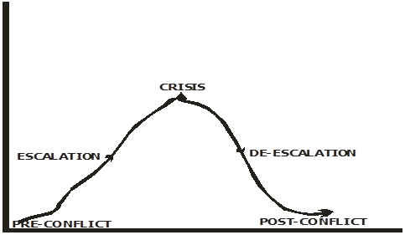

Slide 22
Indicators to show that conflict is in crisis stage i.e. Demolishing, Destruction, Killing, Looting, Burning, etc. At this level of crisis, it is not always advisable for conflict Managers/Experts to jump into the crisis to resolve it. It is rather safer to engage the Security Agencies to wade into the crisis to maintain law and order before conflict Managers engage themselves in the crisis. It is noteworthy to mention here that the best entry point into any crisis is at the outcome level when the heat has come down. If conflict is properly addressed at this point, it may successfully be resolved and may not re-occur.

Slide 23
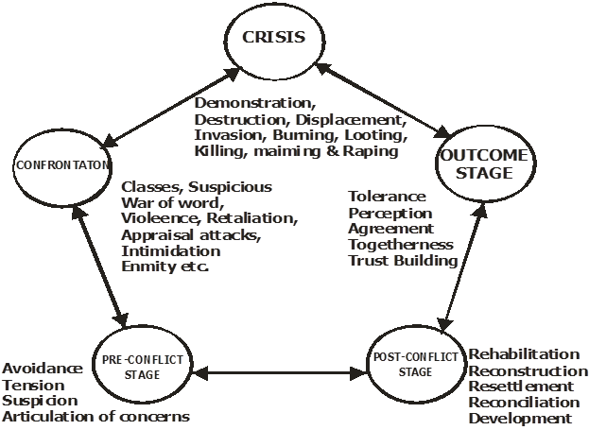
WARNING SIGNS:

Slide 24
Note
NB: This diagram here explains conflict stages from Pre-conflict stage to Post-conflict stage and is important for Conflict Managers as it relates to conflict management and resolution. If the Conflict Manager understands the dynamics and the early warning signals and deals with them accordingly, the conflict may resolve permanently.

Slide 25
The Formation Stage: At this stage, the conflict is latent. Things that were previously taken for granted now become very serious issues. Mere differences become very serious disagreements. The obvious antagonistic shifts in attitude and behaviours show the early warning signs of the conflict at this formation stage and they need to be addressed quickly if further escalation is to be avoided.
Escalation Stage: This stage is characterized by the development of enemy images. People begin to take sides, positions, harden their minds on issues, communication breakdown, perception becomes distorted and parties begin to commit resources to defend their positions. Leaders begin to make inflammatory public statements regarding those positions. Street demonstration is intensified among other nefarious activities.

Slide 26
Violent/Crisis Situation: At this point conflict reaches its peak point and crisis stage. Parties now become physically aggressive to each other. It is a stage of open warfare and confrontation. There is physical barricades, open and organized violence, parties also demarcate their territories - weapons are freely used. There is total breakdown of law and order, and services are completely disrupted e.g schools are closed down, hospitals, market and other public activities are disrupted.
De-Escalation Stage: At this state, there is gradual cessation of hostilities arising from conflict weariness, hunger, sanctions, and/ or external intervention. In conflict management, this is the best period for conflict managers to enter into the crisis in order to broker peace.

Slide 27
6 Improvement Stage: Here there is ceasefire, change of views on both sides of the conflict; people become generally tired and uninterested to continue with the crisis. Normally at this stage, any third party intervention will yield good results.
7 Transformational Stage: This is the post-conflict stage in any conflict situation. At this stage of the conflict all the causes are removed and reconciliation is ready to take root, even though this stage in conflict is desirable, it is hardly attained in any conflict situation. Depending on how well-managed any conflict may be, it will either be transformed by appropriate intervention, or it becomes a vicious circle that cannot break because those handling such conflicts did not remove the cause, or use appropriate conflict tools and techniques/skills to be able to address the conflict head-on as shown below.

Slide 28
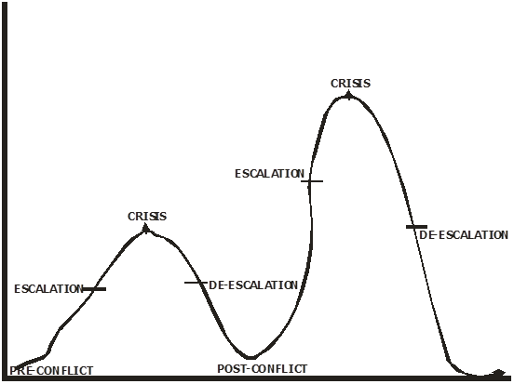

Slide 29
Any stage of conflict can be transformed by appropriate intervention methods/techniques, provided the people themselves are willing to stop the hostilities against one another. Let me emphasis here also that the use of inappropriate approaches, tools and/or skills is responsible for most crises lingering for a very long time. Government and other organizations, including the Church, must endeavor to invest in training Conflict Resolution
Experts/Managers in order to avert crisis and rather build structures of peace and development for the good of the people. Unfortunately, many organizations including the Church hardly invest in building permanent structures of peace as stated above. This is where we as Bishop should avail ourselves the opportunity to embrace the vision of the Church of Nigeria about Justice, Equity and Peace Commission.

Slide 30
Different tools in Conflict Analysis
Just as mechanics have their tools, so do Conflict Managers use appropriate tools in analyzing conflicts. It is, therefore, very pertinent for Conflict Managers to know the needs, interest and the position of the parties in conflict before they can attempt to address it.
In every conflict situation you will discover interestingly that each person or the parties involved always protect their interest: their needs are hidden right in their minds completely undisclosed to the general public-so everyone takes a particular position which is not commonly seen until the Conflict Mangers/Experts dig into it to unveil it. This phenomenon makes most conflicts very complex and complicated to handle. It is in the light of this that the use of tools for conflict analysis is necessary.

Slide 31
I was personally privileged to mediate into two conflict cases that were not only complicated, but also took many years. One of the conflicts lasted for a century and the other lasted for more than seventy years.
There are some conflicts that are older than a normal human lifespan. A conflict of over one hundred and fifty years must surely be older than the oldest surviving personality in your immediate community. Such complicated and long term conflicts cannot be taken for granted.

Slide 32
There are many conflict tools, but, for the purpose of this presentation, I will concentrate on the following:

Slide 33
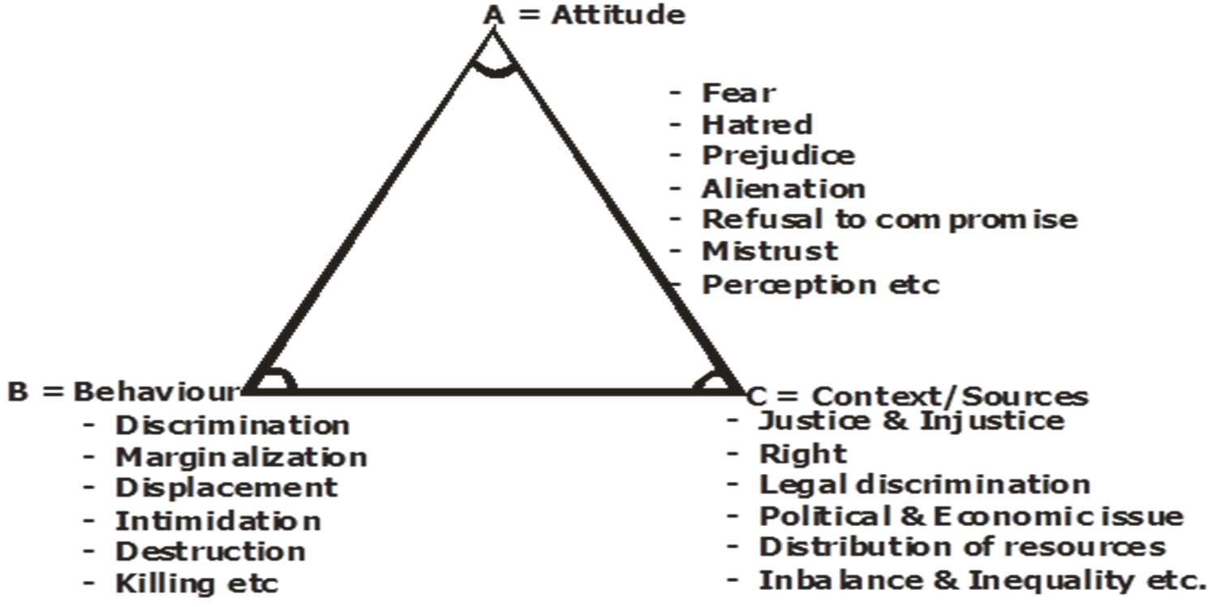
ABC Triangle:

Slide 34
Every conflict has three major components namely: Attitudes, Behaviour and Context/Source. Chris Mitchel noted that every conflict must have these three (3) dimensions. Each of the three

Slide 35
(3) influences the other. This, according to Mitchel, is one important starting point in understanding and dealing with conflict.
In every given conflict situation, the Conflict Manager should note the following:
Attitude: The attitude may relate to: fear, prejudice, hatred, alienation, refusal to compromise, mistrust, perception, etc. as already shown in the diagram above.
Behavior: In behavior, the Conflict Manager/practitioner looks at areas such as discrimination, reprisal attacks, marginalization, displacement, intimidation, destruction, arson, killing, maiming, etc.

Slide 36
Context/Source: This relates to sources of conflict or issues on the ground. In context, therefore, the Conflict Manager considers issues such as imbalances, injustices, abuse of rights, poverty, corruption, maladministration, poor governance, scarce resources among other social vices fringing on the wellbeing of the people that normally result into crisis. Structural conflict can be classified under this group. Structural Conflicts are caused by forces external to the disputants. Poverty can be grouped under this arrangement.
2. Time-Line: This is a very important tool in determining conflict analysis. Time-line is usually used to determine events against time. It helps the Conflict Manager to plot the history of the conflict, as it were, in their chronological order or sequence.

Slide 37
In every conflict situation, parties or groups involved always have different views, dates, experiences and perceptions, which they normally see in the conflict. Each party to the conflict has different histories.
It is, therefore, not to the interest of the Conflict Manager who is the third party and the Mediator to the conflict to begin to argue the dates and their perceptions. All you need to do is take note in a sequence the time-line of their conflict: note all the dates and events as the parties chronicle them.

Slide 38
When Time-line is needed
Time-line should be used early to create understanding for the conflict and to lead the people to the rightful action to be taken. It can also be effective at the later stage to help in strategizing, reflecting and drawing of future plan.
Time-Line Analysis of a crisis between Jogo Community vs. Ajiko Community from April – December 1998.

Slide 39
When Time-line is needed
Time-line should be used early to create understanding for the conflict and to lead the people to the rightful action to be taken. It can also be effective at the later stage to help in strategizing, reflecting and drawing of future plan.
Conflict Mapping: In analyzing conflict, there is what we normally call symbolic representation. Conflict can be represented or expressed through writing, drawing, painting, sculpture, or even songs. Mapping is a technique used to represent the conflict graphically, placing the parties in the conflict in relation to each other on the map.

Slide 40
Conflict Tree:
Conflict Tree Tool Analysis is a tool as well as technique in analyzing root causes to any conflict case. Let it be known that just as the Tree has branches and leaves, so conflict may grow from a small tender age to a full blown conflict; if due attention is not given to it at the initial stage. You cannot easily fall or cut down a grown-up tree unless you are able to remove the roots.
Most conflicts have long lingered unabated because the root causes have not been addressed. As the diagram here shows, what is hidden under the conflict tree is so imbedded that cutting off the branches alone will not resolve the entire problem. What one needs to address is the roots hidden right underground. That is exact situation with conflict. Removing the branches of the conflict will not stop it until the underground problems are unveiled, addressed and completely removed.

Slide 41
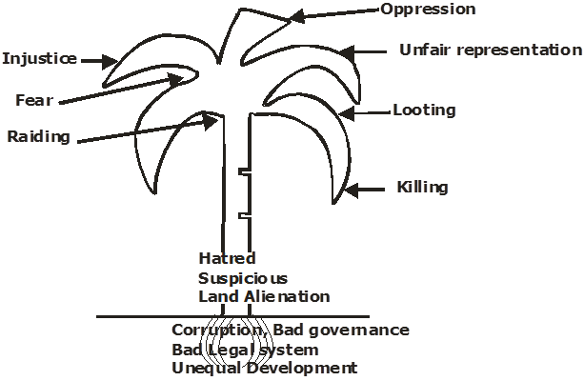

Slide 42
Poor leadership, promulgation of bad laws, coupled with Colonial boundaries and unequal distribution of God-given resources are root causes to many conflicts we have in our society today. Most Nigerians attribute the current socio-economic and political problems in our Country to the Amalgamation policy of Lord Lugard in
1914 where the different ethnic nationalities were all put together into a nation called Nigeria. If this is acceptable historical theory and a possible reason for our socio-political problem, the only way to attain our desired National unity may be to call for a National Conference or Referendum.

Slide 43
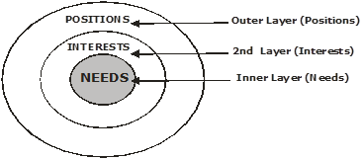
THE USE OF ONIONS/DOUGHNUT TOOL:

Slide 44
It is important for the Conflict Managers to know the interests, needs and positions the parties in conflict have before they can attempt to address it any conflict situation.
In this case, the use of doughnut or onion tool can easily help to determine the situation.
In every conflict situation, these three positions must be observed. You will discover that people protect their interest, which is the 2nd layer of the Onion/Doughnut: their needs will be hidden right inside and usually undisclosed to the public. For example, there is constant disagreement between a couple at night

Slide 45
Each time you discuss with the husband, he complains that his wife is uncooperative, stubborn, etc. Meanwhile, the undisclosed needs may be that his wife is resisting him in bed. In every conflict, there is an “innermost need” hidden right inside. The combatant parties only take positions to defend their interests and their needs. The Conflict
Manager through his/her various expert tools will be able to dig deep down or remove all the layers to find out what are the hidden needs before reasonable resolution will be finally reached. You cannot reach any reasonable resolution in any conflict as a conflict Manger/Practitioner if the only tool you have in Management of conflict is always hammer. There are times the conflict Manager/Practitioner uses multiple tools to analyze and resolve conflict

Slide 46
Biblical Principles of Conflict Resolution and Peace Building
It is clear that conflict is inevitable and it is as old as creation itself. The first crisis ever recorded is the conflict between God and the devil (Lucifer). Isaiah 14:12-15 ¹² How art thou fallen from heaven, O Lucifer, son of the morning! how art thou cut down to the ground, which didst weaken the nations!
¹³ For thou hast said in thine heart, I will ascend into heaven, I will exalt my throne above the stars of God: I will sit also upon the mount of the congregation, in the sides of the north: ¹⁴ I will ascend above the heights of the clouds; I will be like the most High. ¹⁵ Yet thou shalt be brought down to hell, to the sides of the pit. The Crisis took place right in Heaven.

Slide 47
The fall of man in Gen. 3:1-24
clearly depicts another conflict: ¹ Now the serpent was more subtil than any beast of the field which the LORD God had made. And he said unto the woman, Yea, hath God said, Ye shall not eat of every tree of the garden? ² And the woman said unto the serpent, We may eat of the fruit of the trees of the garden: ³ But of the fruit of the tree which is in the midst of the garden, God hath said, Ye shall not eat of it, neither shall ye touch it, lest ye die. ⁴ And the serpent said unto the woman, Ye shall not surely die: ⁵ For God doth know that in the day ye eat thereof, then your eyes shall be opened, and ye shall be as gods, knowing good and evil… Gen 3:1-24 (KJV)
The whole of this chapter from Vs. 1 – 24 records the discourse of the conflict man experienced in the Bible. This is a Conflict about broken relationship and mistrust. God’s intention in man’s

Slide 48
creation was that man should be His representative on earth, to rule and have dominion over all the creation of the earth.
The opening Chapter Gen. 1:26 records the Host of Heaven saying “Let us make man in our own image, in our own likeness and let them rule over the fish of the sea and over the fowl of the air, and over the cattle, and over all the earth, and over every creeping thing that creepeth upon the earth.
(cf Psalm 82: 6-7). “I have said, ye are gods; and all of you are children of the most high. But ye shall die like men…”

Slide 49
God proclaimed that everything He created was very good. The broken relationship at the Garden of Eden and raining of curses on humanity by God Himself is a clear evidence of conflict and crisis right from the time of creation.

Slide 50
The story of the Tower of Babel in Gen
. 11:1 – 9; especially in Vs 7: ‘come let us go down and confuse their Language so that they will not understand each other’. Vs 8, ‘So the Lord scattered them from there over all the earth and they stopped building the city’. That is why it was called Babel – because there, the Lord confused the language of the whole world. This is another form of crisis dissipated by God Himself soon after the fall of man in the Garden of Eden.

Slide 51
Again in Gen. 13:1ff, Abram separated with Lot. Vs 8,
So ‘Abram said to Lot “Let’s not have any quarreling between you and me or between your herdsmen and mine, for we are brothers.” Let’s part company. If you go to the left, I will go to the right, if you go to the right, I will go to the left”.
Vs 11, ‘So Lot chose for himself the whole plain of the Jordan and set out towards the East’. The two men parted company. The two, Abram and his nephew, Lot, parted way in order to give peace a chance. Abram here used avoidance conflict style to separate with his nephew Lot.

Slide 52
The story of Esau and Jacob in Gen. 27
Gen. 27:1ff narrates how Jacob stole his Elder Brother’s blessings. Esau and Jacob were twin brothers (cf Gen. 25:19 – 28 ¹⁹ And these are the generations of Isaac, Abraham's son: Abraham begat Isaac…
Because of this incidence as recorded in Gen 25, Esau held a painful grudge against Jacob because of the blessing his father had given to him. He said to himself, “the days of mourning for my father are near, then I will kill my brother Jacob.”
When conflict is not addressed, it gives birth to open crisis and eventually plot for murder as evident in this passage. James 4:1-2a ¹ From whence come wars and fighting among you? come they not hence, even of your lusts that war in your members? ² Ye lust, and have not: ye kill, and desire to have, and cannot obtain: ye fight and war, yet ye have not, because ye ask not.

Slide 53
Joseph was sold by his brothers. Gen. 37:12 – 17a; Vs 17b,
, “Joseph went after his brothers and found them near Dothan. But his brothers saw him from afar, and before he reached them, they plotted to kill him. Vs 23, “So when Joseph came to his brothers, they stripped him of his robes – the richly ornamented robe he was wearing and they threw him into the cistern”.
Joseph’s brothers were envious of him; they hated him because of his dreams. Hatred, malice, envy, jealousy are the main causes of conflict World over. The Bible enjoins us Christians not to allow our conflict to linger on until sunset. Eph. 4:26 ²⁶ Be angry without doing wrong; let not the sun go down on your wrath. .

Slide 54
New Testament Account
Matt 18:15-17
"If your brother sins against you, go and show him his fault, just between the two of you. If he listens to you, you have won your brother over. 16 But if he will not listen, take one or two others along, so that 'every matter may be established by the testimony of two or three witnesses.' 17 If he refuses to listen to them, tell it to the church; and if he refuses to listen even to the church, treat him as you would a pagan or a tax collector. NIV
Scripture tells us that we are follow members of God’s own family as well as members of the Body of Christ

Slide 55
Compare Romans 12:5
Matt 18:15-17
"If your brother sins against you, go and show him his fault, just between the two of you. If he listens to you, you have won your brother over. 16 But if he will not listen, take one or two others along, so that 'every matter may be established by the testimony of two or three witnesses.' 17 If he refuses to listen to them, tell it to the church; and if he refuses to listen even to the church, treat him as you would a pagan or a tax collector.
Compare Rom 12:5. So in Christ we who are many form one body, and each member belongs to all the others.

Slide 56
Matt 18:15-17
"If your brother sins against you, go and show him his fault, just between the two of you. If he listens to you, you have won your brother over. 16 But if he will not listen, take one or two others along, so that 'every matter may be established by the testimony of two or three witnesses.' 17 If he refuses to listen to them, tell it to the church; and if he refuses to listen even to the church, treat him as you would a pagan or a tax collector.
Rom 12: 5, So in Christ we who are many form one body, and each member belongs to all the others.

Slide 57
Rom 12:16-19
Rom 12:16-19 Live in harmony with one another. Do not be proud, but be willing to associate with people of low position. Do not be conceited. Do not repay anyone evil for evil. Be careful to do what is right in the eyes of everybody. If it is possible, as far as it depends on you, live at peace with everyone.
If you become aware you have offended someone, you should go even to greater lengths to seek their forgiveness and reconciliation. Mathew 5:23-24.

Slide 58
Conclusion
As I conclude, may I make this passionate appeal to all the participants of this training to apply all that they have learnt today to make a difference in their various groups, Churches, Parishes, Archdeaconry and Dioceses at large to the glory of God Almighty.

Slide 59
Thanks and God bless

Slide 60
ANNOTATED BIBLIOGRAPHY
Fisher S. et-al(2000) Working with Conflict: (Skills and Strategies);
London, Zed Books Ltd.
Inyom N.N.(2016) A Handbook on Conflict Management, Resolution and Peace Building.
Abeokuta, Crowther Theological Seminary Publishers.
Nwankiti Jane (2015) Principles of Conflict Resolution and Crisis Management in the Church.
Owerri, Spectro Digitals Ltd.
Church of Nigeria Vision( Latest Edition)
Justice, Equity and Peace Commission(JEPC) doc,
Holy Bible (NIV, ESV)

